Slide 1
rev.health
The ambient-AI-native EMR that gives time back to the exam room —
and gets independent practices paid correctly the first time.
SEED ROUND · $3M · 2026
[Founder name] · founders@rev.health

Slide 2



THE PROBLEM
Independent primary care is being squeezed from both ends
2–3 hrs
5–10%
30–60
of after-hours “pajama-time” charting per clinician, every night
revenue leakage from fragmented billing and untriaged denials
day AR cycles, with billing staff spending 70% of time on rework
The incumbents have outgrown this buyer. Cloud suites price for big groups; budget EMRs ship weak interop and aging UX. The 1–5 clinician practice — health IT’s largest underserved segment — is left behind.
rev.health — confidential
2

Slide 3
WHY NOW
A once-per-decade regulatory window is open
Jan 2026
Mar 2026
Live now
FY 2026
Jan 2027
USCDI v3 mandatory
HTI-1 enforcement begins
TEFCA: 11 QHINs,
10,600+ orgs
HTI-4: ePA, eRx,
RTPB
CMS-0057-F payer
& prior-auth APIs
Every incumbent must retrofit. We get to start native. Independent practices cannot fund FHIR, payer-API, and certification uplifts alone — a vertically integrated platform that is FHIR-native, AI-native, and TEFCA-connected from day one wins the segment.
rev.health — confidential
3

Slide 4
THE SOLUTION
One platform: EHR + practice management + RCM, AI-native
Built around two promises:
10 MODULES, ONE DATA MODEL
Ambient clinical doc
Scheduling
The note is done before the clinician leaves the room
Structure-first ambient scribe fills coded fields — problems, meds, orders — with every line traceable to the audio.
Eligibility & prior auth
eRx & EPCS
RCM & denials
Coding & CDS
The practice is paid correctly the first time
Referrals
Patient portal
Native charge capture → 10K+ rule scrubbing → auto-posting → AI denial triage. Target ≥98% first-pass clean claims.
Task management
Payer optimization
Dark = wedge modules in seed-funded MVP scope
rev.health — confidential
4

Slide 5




HOW WE'RE DIFFERENT
Four things no incumbent ships today
Structure-first ambient scribe
Resource-graph scheduling
Writes back into the problem list, A/P, and orders as coded fields, each linked to audio evidence. Not a transcript.
Minute-level constraint solver across clinicians, rooms, staff, and equipment. Nothing off-the-shelf exists for small practices.
Turn-key integrated RCM
FHIR-native, TEFCA day one
Athena still needs you to hire a biller. We don’t: capture → scrub → submit → post → appeal, natively.
USCDI v3 baseline, CMS-0057-F prior-auth APIs, QHIN connection at launch — compliance as a feature, not a retrofit.
rev.health — confidential
5

Slide 6



THE MOAT
Patients are users. Clinical data is global.
Every other EMR locks the chart inside the practice. We invert the model: the patient owns one portable record; practices connect to it.
One identity
Every read audited
Compounding data
Patient = user. Switch practices, the chart travels intact. No re-entry, no faxes.
Patients see who viewed their record and why — a first-class feature, not a buried report.
Each new practice deepens the longitudinal record — over time, more complete than Epic's view for our patients.
Network effect: every practice added makes the product more valuable to every patient — and harder to leave.
rev.health — confidential
6

Slide 7
COMPETITION
We demoed them all — here's what the buyer actually faces
Vendor | Price signal | What the demos exposed (2026, recorded)
athenahealth | 4–7% of collections + ~$140/prov/mo | RCM not turn-key — practice must still hire its own billing coordinator. Lukewarm on small practices.
eClinicalWorks | $449–599/prov/mo + 2.9% RCM | $155M DOJ False Claims settlement; AI features failed live in our demo; export = support case.
NextGen | Quote-based + $125/prov/mo AI add-on | 2023 breach: 1.05M people, $19.4M settlement. Rep couldn't produce breach indemnity language.
Elation | ~$300–450/prov/mo (opaque) | Closest in spirit, but no integrated RCM, no resource-graph scheduling, no structured scribe write-back.
rev.health: $399/prov/mo + 3.5% of collections — integrated, transparent, and built for the 1–5 clinician practice.
rev.health — confidential
7

Slide 8
MARKET
The largest underserved segment in ambulatory health IT
$15B+
~$4B
$46M
US ambulatory EHR / PM / RCM software & services (TAM)
Independent primary care, 1–5 clinicians — bottom-up: ~60K practices × ~$65K ACV (SAM)
Exit ARR at 850 practices by 2031 — ~1.4% of segment (SOM)
Expansion: the same platform serves high-collections specialties (ortho, cardio, GI), where RCM yields a multiple of per-provider revenue — pure ACV upside after the beachhead.
Sizing is bottom-up illustrative; sources and math in the data room.
rev.health — confidential
8

Slide 9
BUSINESS MODEL
Two revenue engines per provider
SaaS subscription
Integrated RCM
$399 /provider/mo
3.5% of collections (80% attach)
EHR, scheduling, eRx/EPCS, portal, scribe included
vs. athenahealth 4–7% — and ours includes denial work
~$26K
~$65K
77%
Short cycles
revenue per provider / yr
ACV per practice (2.5 providers)
blended gross margin
one-clinician buying decision
Year-1 design partners at 50% discount; full pricing at GA (2028).
rev.health — confidential
9

Slide 10
FINANCIAL PLAN
Path to $26M revenue by 2031
650
practices by 2031 (from 4 design partners in 2027)
$35M
exit ARR run-rate, 2031
2028
GA launch after ONC certification; $10M Series A assumed mid-year
+$6.2M
EBITDA in 2031; 77% gross margin
Full 5-year model with assumptions in the data room.
rev.health — confidential
10

Slide 11
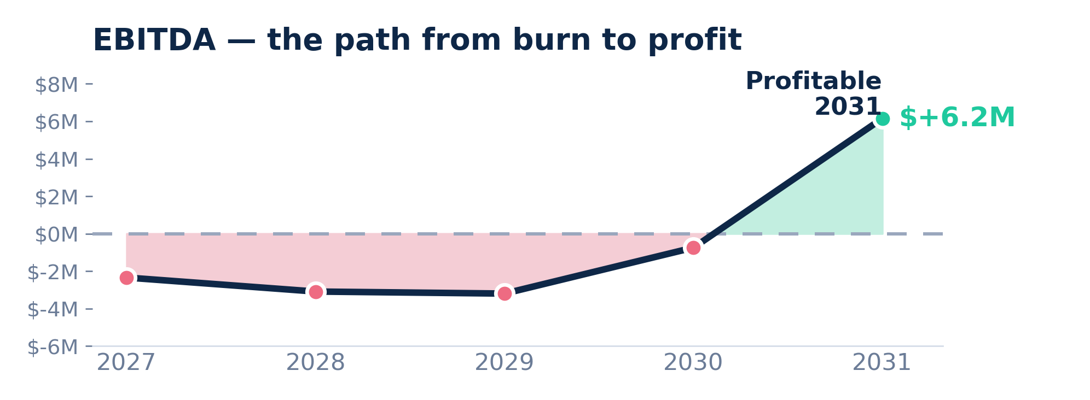
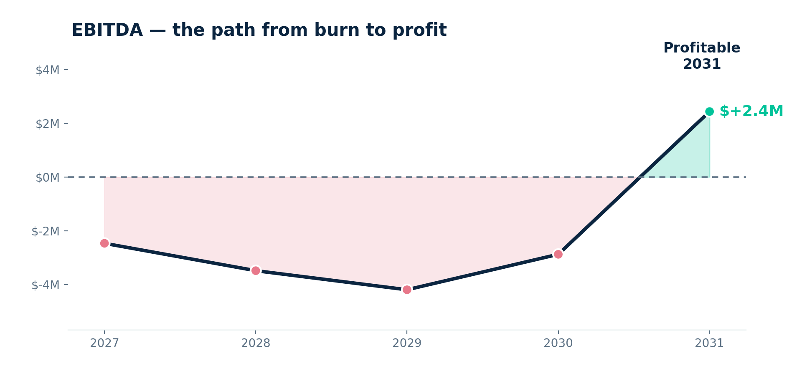
PATH TO PROFITABILITY
Burn turns to profit.
Seed funds the trough; integrated RCM and a 77% gross margin carry EBITDA to +$6.2M by 2031.
rev.health — confidential
11

Slide 12




ROADMAP
Certification is the critical path — and it starts now
H2 2026 — P0
2027 — P1
2028 — P3 GA
2029+ — P4
Foundation
Alpha with design partners
Certified launch
Expansion
Team hired, architecture stood up, Drummond ONC + Surescripts EPCS kicked off (9–12 mo each).
Scheduler, ambient scribe, eligibility, charge capture, eRx live in 3–4 friendly clinics. Paying design partners.
ONC cert complete, full RCM with denials & appeals, MIPS, TEFCA, SOC 2 Type II. General availability.
Specialty verticals, telehealth, HITRUST i1, Bulk FHIR, predictive scheduling. Scale to 110+ practices.
Seed funds carry the company through GA-readiness; Series A (assumed H2 2028) funds the go-to-market scale-up.
rev.health — confidential
12

Slide 13




WHERE WE ARE
De-risked before a single line of production code
10-module PRD: exec, developer, and data-model views — 44 documents, validated
NEXT 90 DAYS
Full regulatory matrix: 15 frameworks mapped to product posture and timeline
Close seed round
Competitive teardown incl. recorded 2026 vendor demos (athenahealth, NextGen)
Sign 3–5 design-partner LOIs
Working UI prototypes: dashboard, scheduling day-view, live status board + 6 more
First 4 engineering hires
Architecture decided: FHIR-native, schema-first codegen, patients-as-users model
Drummond + Surescripts kickoff
rev.health — confidential
13

Slide 14
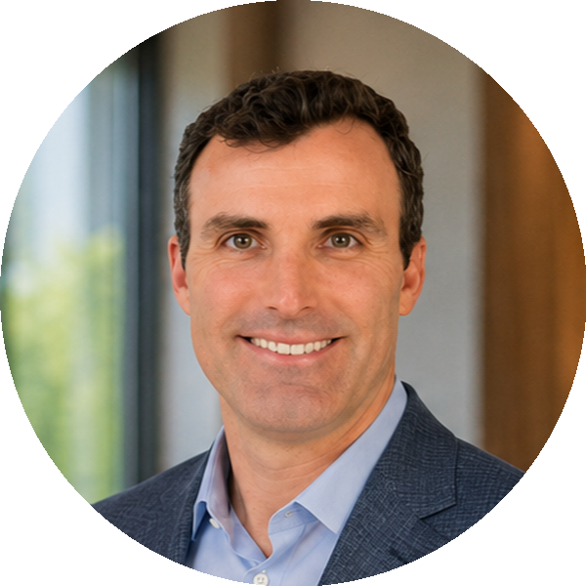

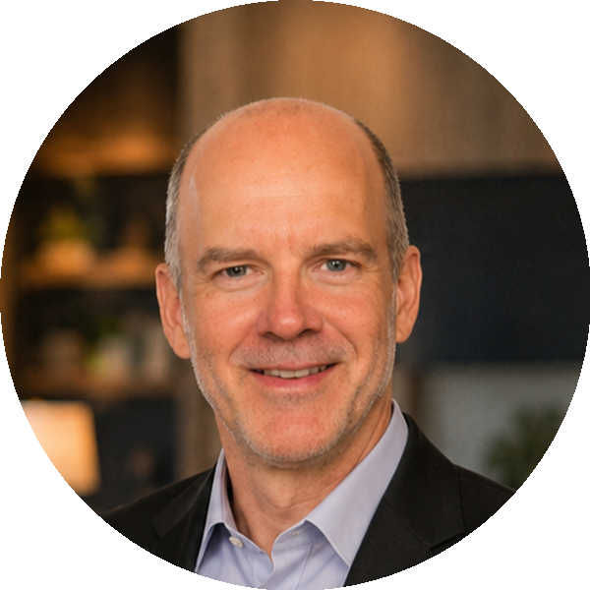
TEAM
Built by people who've lived the problem
Patrick Feeney
Jeff Hughes
Daniel Dow, M.D.
Co-founder & CEO
Co-founder & CTO
Co-founder & Subject-Matter Expert
Investor, founder, and advisor based in Dallas. Leads strategy, fundraising, and go-to-market.
Technical founder and architect of the rev.health platform — from the data model to the ambient-AI workflows.
Physician, venture partner, and founder championing autonomy and ownership in medicine. Empower Health; Columbia Business School.
Advisory board in formation: RCM operator, health-IT regulatory counsel, 2 practicing PCPs.
rev.health — confidential
14

Slide 15
EXIT STRATEGY
A clear path to a strategic exit.
STRATEGIC EMR / RCM
athenahealth · eClinicalWorks · NextGen
Buy a FHIR-native, AI-native platform — and the 1–5 clinician segment they can’t serve profitably.
PAYERS & RETAIL HEALTH
Optum · CVS / Aetna · Amazon
Own the patient-as-user longitudinal record and the value-based-care rails it runs on.
PE ROLL-UPS & GROWTH
Primary-care consolidators
Acquire the modern stack independent practices actually adopt and stay on.
Health-IT M&A clears 4–8× ARR.
At ~$35M exit ARR (2031), that is a $140–$280M outcome — and the Series A milestone keeps every path open.
rev.health — confidential
15

Slide 16
THE ASK
$3M seed to reach certified general availability
57% Engineering & product
15% Regulatory & certification
10% Design partners & GTM
8% G&A, legal, insurance
10% Contingency
WHAT IT BUYS BY SERIES A (H2 2028)
ONC §170.315 + EPCS certification complete
4 design partners live and paying
Wedge product live: scribe, scheduling, RCM core
~$1.5M exit ARR run-rate entering GA year
founders@rev.health
rev.health — confidential
16

